Slide 1
Cluster-Connector
Build a Bridge Between Core/Edge Clusters

Slide 2
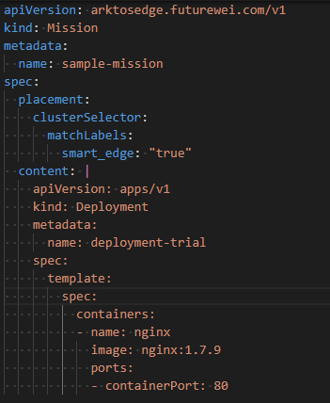
Cluster-Connector
Mission: a CRD defined for cluster connections. Containing:
Content: what workload to propagate
Placement: which clusters should get it
Core
Watch for Mission
Edge
Non-Intrusive, run independently
Two commandline options, the kubeconfig of the core and edge clusters
Easily Configured

Slide 3
Worklfow of Cluster-Connector
Load the Cluster Name and Labels
Apply the CRD of Mission
Watch the master cluster for mission
Add/update
delete
Apply the mission CR
Delete the mission CR
Apply the mission content
delete the mission content

Slide 4
Cluster Selection
Following the pattern of Federation (https://github.com/kubernetes-sigs/kubefed/blob/master/docs/userguide.md#using-cluster-selector)
Scheme:
spec.placement.clusters: explicitly specify clusters
spec.placement.clusterSelector: a label selector to determine a list of clusters at runtime

Slide 5
Demo Configuration
cluster
cluster
cluster
Name: Arktos-1 label: smart_edge: true
Name: Arktos-2 label: none
Name: Arktos-3 label: smart_edge: true

Slide 6
